Slide 1
Intro to .NET Microframework and it’s compatible dev boards
IOT BANDUNG MAKER DAY

Slide 2
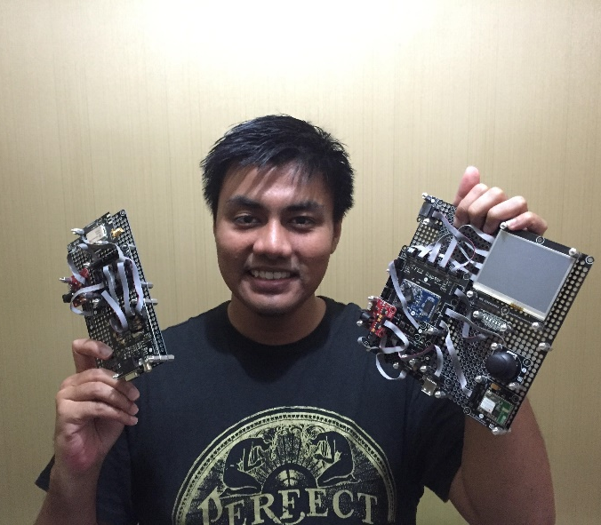
SO WHO’S TALKING ?
n: Fadhil
e: fadhil@Gravicode.com
t: @Gravicode
t: @mifmasterz
c: facebook.com/netgadgeteerindonesia
w:Gravicode.com
v:youtube.com/mifmasterz

Slide 3


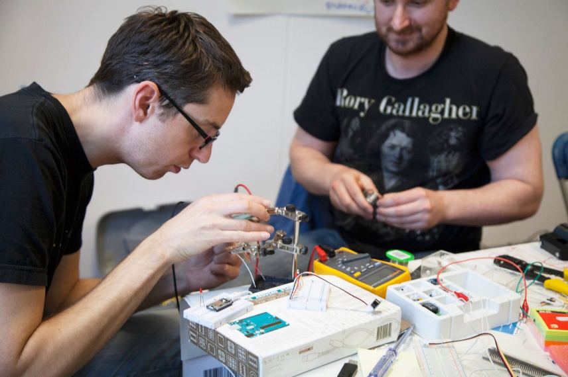
BEFORE WE START, SO WHAT’S MY GOAL ?

Slide 4



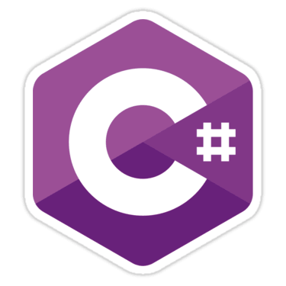
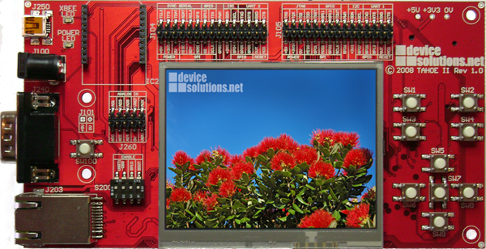
LET’S GO BACK TO THE TOPIC…
What’s .NET Microframework ?

Slide 5
WHY .NET MICROFRAMEWORK ?
Great Dev Experience
Rapid Prototyping
Leverage .NET and C#

Slide 6
Segments
Developer | Educators
Hobbyist & Inventor | Electronic / Dev Board Manufacture

Slide 7
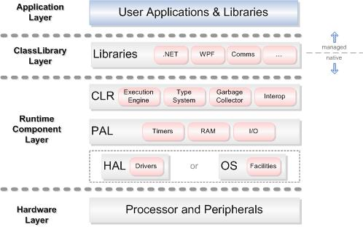
.NET Microframework Architecture

Slide 8
WHAT YOU NEED TO GET STARTED
Hardware
Choose your dev board
IDE & SDK
Visual Studio 2013/ 2015 Community
Drivers & Libs
Install hardware specific drivers & library
.Net Microframework SDK
.NETMF VSIX Extension
(eg. Gadgeteer Core, SDK, and Extension)

Slide 9
…
Now I’ll continue with a specific prototyping platform which is built on top of the .NET Microframework..
.NET Gadgeteer

Slide 10
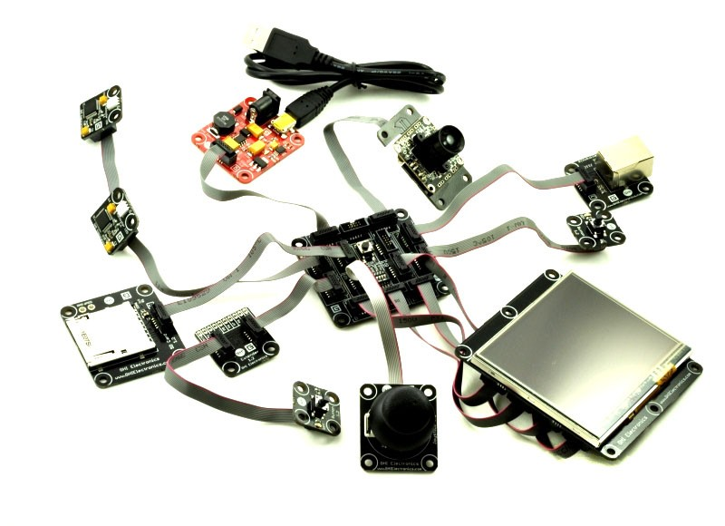
WHAT IS GADGETEER ?
​.NET Gadgeteer is a rapid development platform that utilizes mainboards and plug-and-play modules to build electronic projects, without the need for an electronics background.

Slide 11
HISTORY
.NET Gadgeteer was created by researchers at Microsoft Research Cambridge, where the Sensors and Devices group created it as a way develop device ideas rapidly and iteratively. It quickly generated interest from hobbyists, teachers, and developers, who wanted a platform to build gadgets in a short time.
In response to outside interest, Microsoft then released Gadgeteer as an open source software project, describing the project as "an open collaboration between Microsoft, hardware manufacturers, and end users".
The core libraries are published under the Apache 2.0 License, while the hardware designs are under the Creative Commons 3.0 License. The core source code is publicly available from the CodePlex source repository.
Microsoft has stated plans to continue supporting and investing in the .NET Gadgeteer ecosystem, including hosting educational materials and working with companies to create compatible kits and modules.

Slide 12
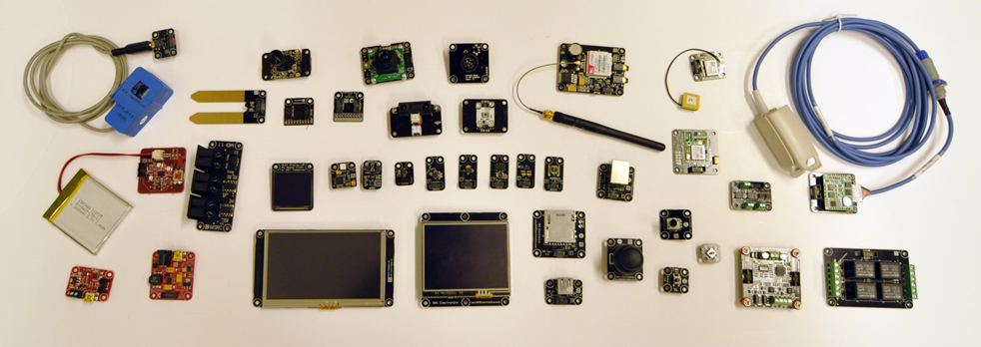
SO WHAT ?
You can make your prototype in minutes, just plug and play….
a lot of modules…
includes the drivers…

Slide 13
SO WHAT ?
NET Gadgeteer software works on top of the .NET Micro Framework (NETMF) software and it has many advantages:
It is programmed using Microsoft's Visual Studio IDE, even the free version.
.NET Micro Framework is open-source and free.
Your same code will run any NETMF device with almost no changes.
Full debugging capabilities (breakpoints, stepping in code, variables...etc.)
“Has been tested in many commercial products, with assured quality. “
Includes many bus drivers (SPI, UART , I2C...etc.)
Eliminates the need to use the complicated and long processors' datasheets.
If you are already a PC .NET programmer then you already know NETMF.

Slide 14
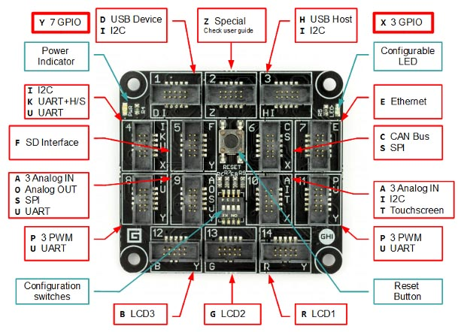
HARDWARE – DEV BOARDS
Specifications
Processor | 120 MHz 32-bit ARM Cortex-M3
User Available Flash | 2.87 MB
User Available RAM | 13.67 MB
GPIO | 70
PWM | 6
Analog In | 6
UART | 4
SPI | 2
I2C | Yes
Networking | Ethernet TCP/IP, WiFi, and SSL
CAN | 1
USB Client & Host | Debugging, Yes
RTC | Yes
IFU | Yes
RLP | Yes, 1 MB RAM Size
Native LCD Controller | Yes
FEZ SPIDER II

Slide 15
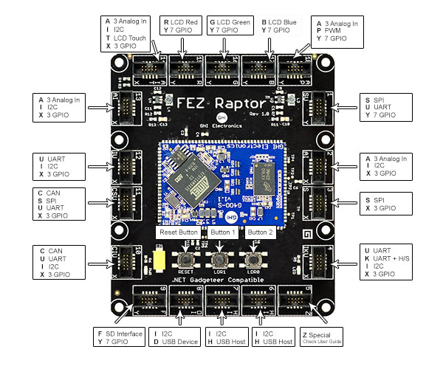
HARDWARE - DEV BOARDS
Specifications
Processor | 400 MHz 32-bit ARM 9
User Available Flash | 1.4 MB
User Available RAM | 92 MB
GPIO | 88
PWM | 4
Analog In | 12
UART | 6
SPI | 2
I2C | Yes
Networking | Ethernet TCP/IP, WiFi, and SSL
CAN | 2
USB Client & Host | Debugging, Yes
RTC | Yes
IFU | Yes
RLP | Yes, 24 MB RAM Size
Native LCD Controller | Yes
FEZ RAPTOR

Slide 16
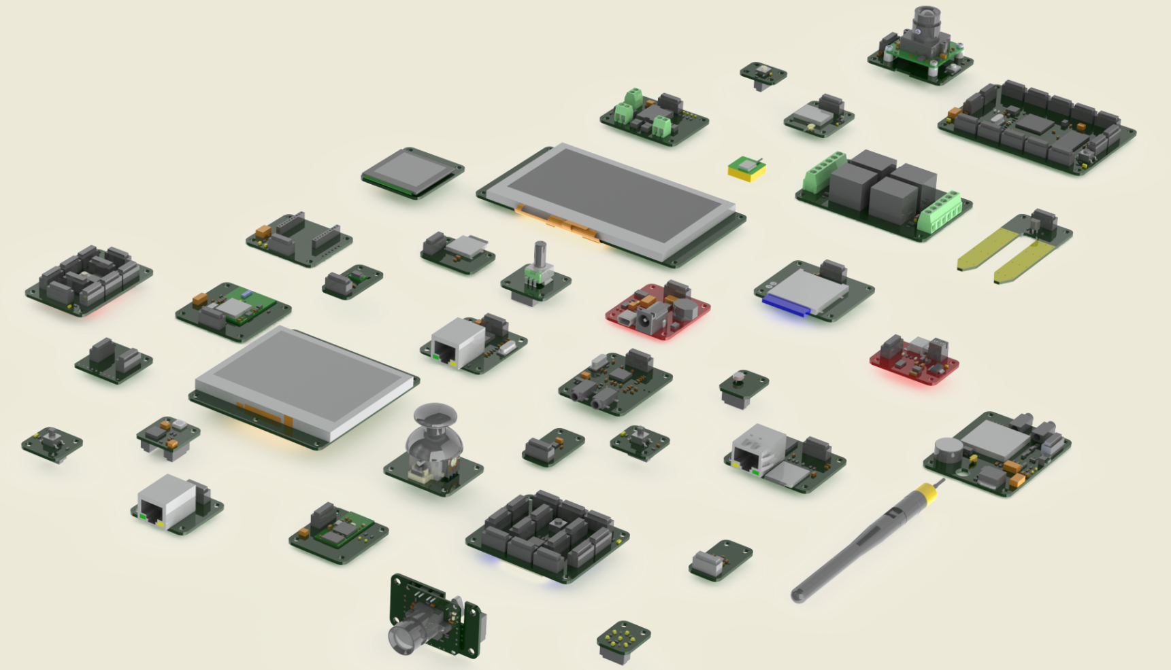
HARDWARE - MODULES

Slide 17
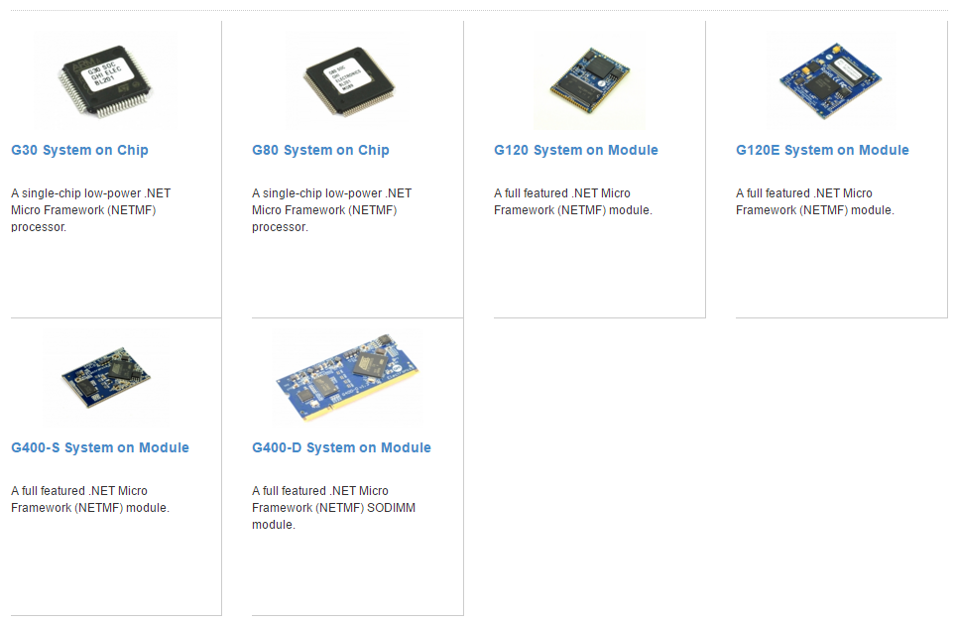
HARDWARE - SOC / SOM

Slide 18
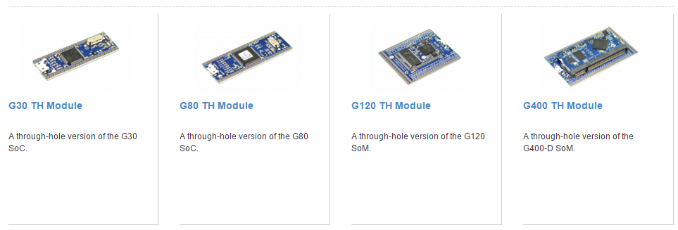
HARDWARE – THROUGH HOLE

Slide 19






GADGETEER MANUFACTURES
Mountaineer Group

Slide 20

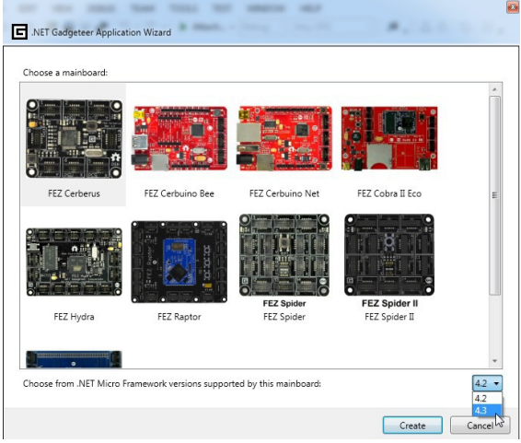
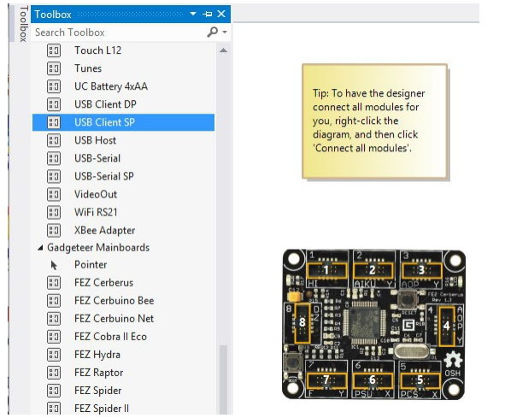
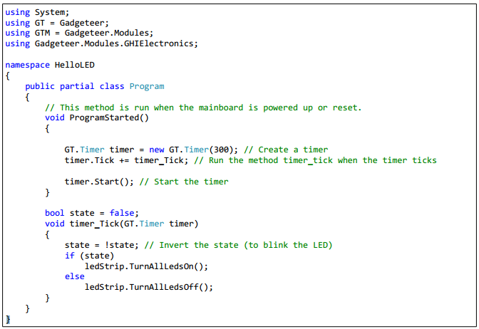
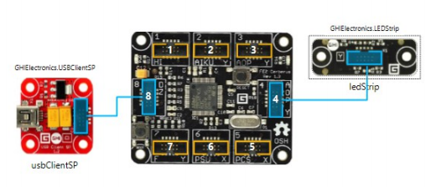
SOFTWARE ?
Choose Your Board
Drag some modules
Type some code and Execute..

Slide 21
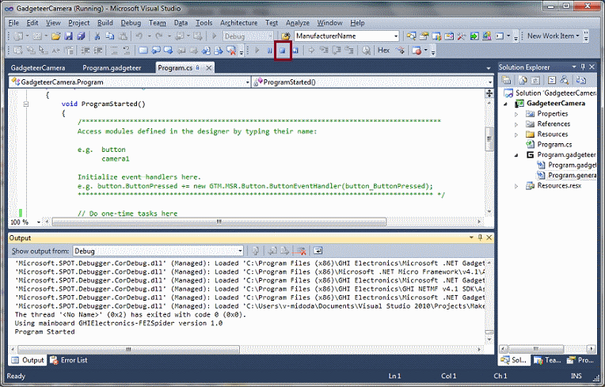
GOOD NEWS FOR YOU…
You can debug directly
using Visual Studio !!

Slide 22
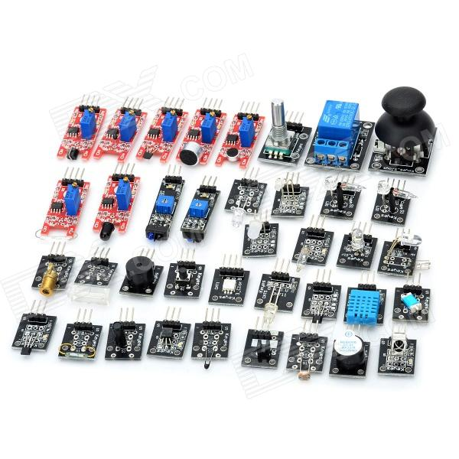
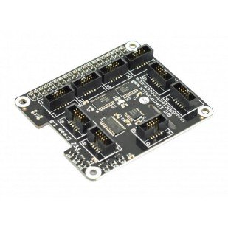
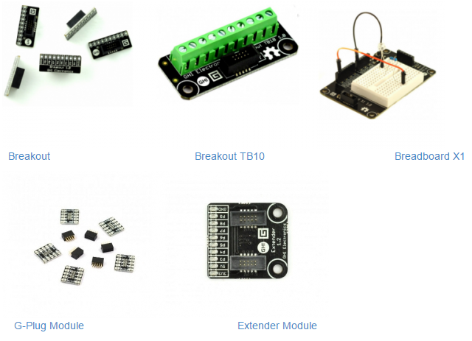
GADGETEER + ARDUINO COMPATIBLE SENSORS / ACTUATORS / MODULES = AWESOME & CHEAP!!
Gadgeteer Boards/Hats
Breakout Modules
Arduino compatible sensors / actuators

Slide 23
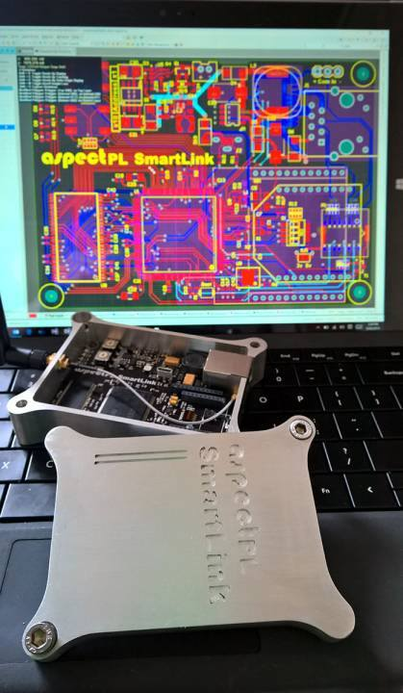
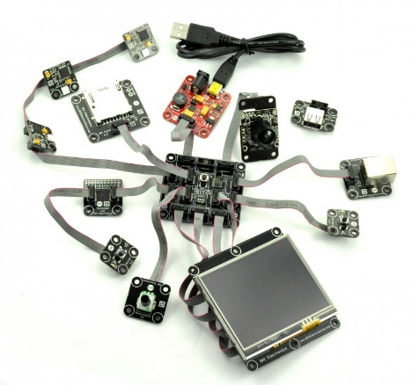
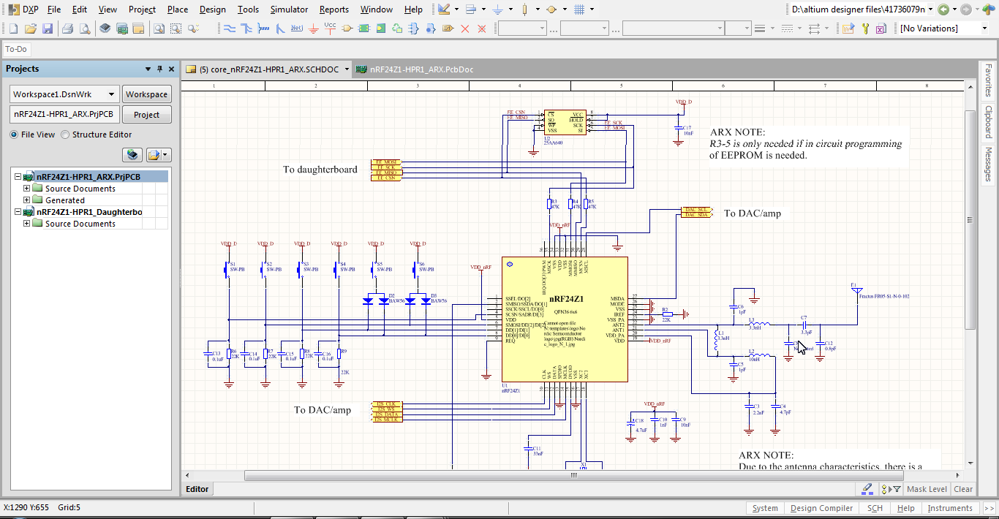
FUN OR SERIOUS ? BOTH…
Prototype to Production Path…
Create your Prototype
Design your own circuit with hardware consultant
Keep your code using Gadgeteer Library or Switch to Pure .NET Microframework
Design your case

Slide 24
LET’S SEE SOME DEMO…
DEMO 1: Let’s create your own camera

Slide 25
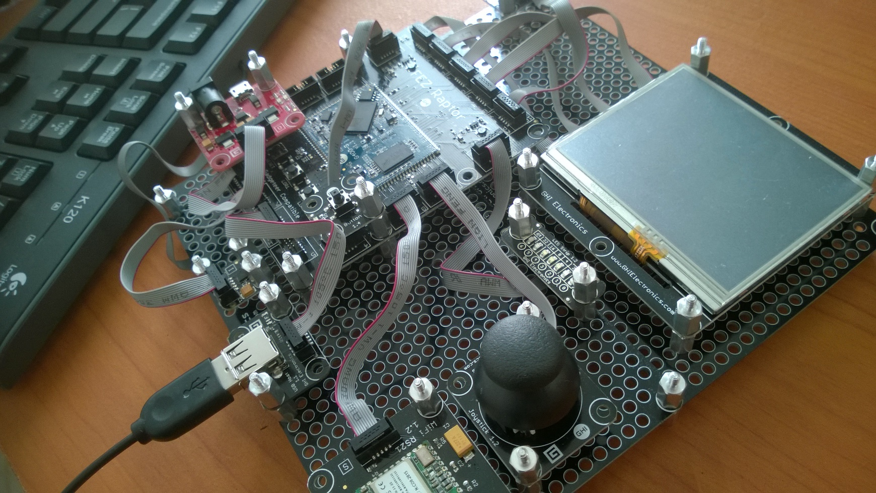
LET’S SEE SOME DEMO…
DEMO 2: Create your own ‘game arcade’ !!

Slide 26
LET’S SEE SOME DEMO…
DEMO 3: Remote Monitoring with LORA !!

Slide 27
LET’S SEE SOME DEMO…
DEMO 4: Create your own shell based ‘Operating Environment’ with awesome features !!

Slide 28
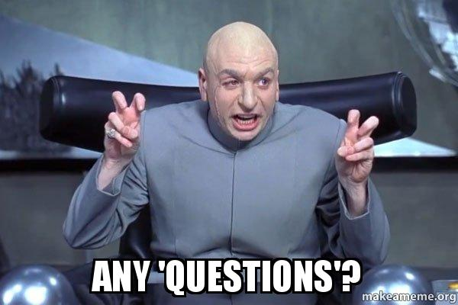
LET’S TALK…

Slide 29
ADDITIONAL INFORMATION
Technical details

Slide 30
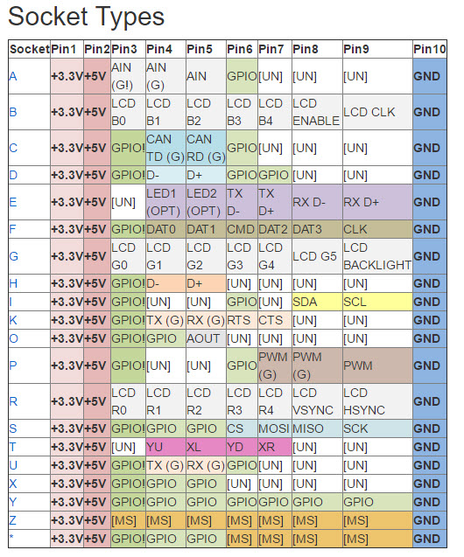
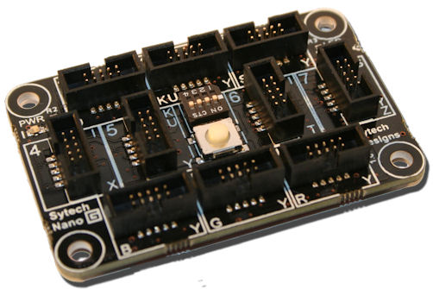
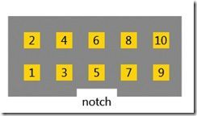
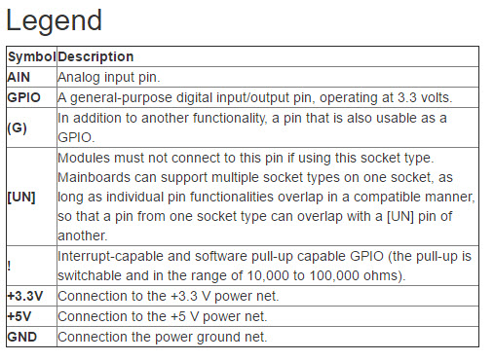

Slide 31
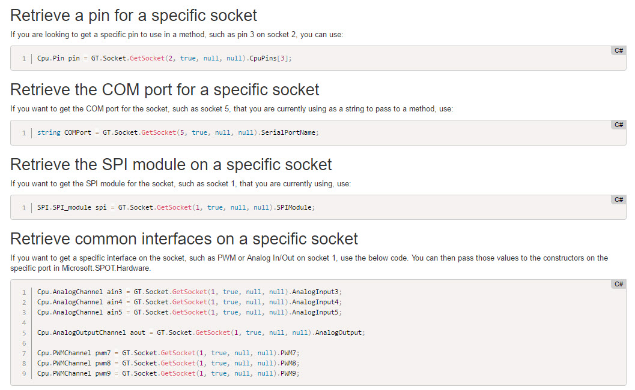
ACCESSING PINS FROM SOCKET

Slide 32
THANK YOU
See you in another chapter…
Please visit our page:
facebook.com/netgadgeteerindonesia
And share your ideas and awesome ‘things’ to us…

